Slide 1
SWEEPING LINES
Dr. T Joshva Devadas

Slide 2
Sweeping lines
Determining whether any pair of segments intersects in a given set of line segments, called as Sweeping algorithm
The algorithm runs in O(n lg n)time, where n is the number of segments we are given. It determines only whether or not any intersection exists; it does not print all the intersections

Slide 3
Sweeping lines
In sweeping, an imaginary vertical sweep line passes through the given set of geometric objects, usually from left to right the sweep line moves across, in this case the x-dimension, as a dimension of time.
Sweeping provides a method for ordering geometric objects, usually by placing them into a dynamic data structure, and for taking advantage of relationships among them.
The line-segment-intersection algorithm considers all the line-segment endpoints in left-to-right order and checks for an intersection each time it encounters an endpoint

Slide 4
Assumptions:
No input segment is vertical.
No three input segments intersect at a single point. E
Ordering segments
As there is no vertical segment, any input segment intersecting a given vertical sweep line intersects it at a single point.
Thus, we can order the segments that intersect a vertical sweep line according to the y-coordinates of the points of intersection.

Slide 5

Consider the line segments s1 and s2. we say that these segments are Comparable at x if the vertical sweep line with x-coordinate x intersects both of them.
We say that s1 is ABOVE s2 at x and written as
If s1 and s2 are comparable at x and the intersection of s1 with the sweep line at x is higher than the intersection of s2 with the same sweep line, or if s1 and s2 intersect at the sweep line.

Slide 6
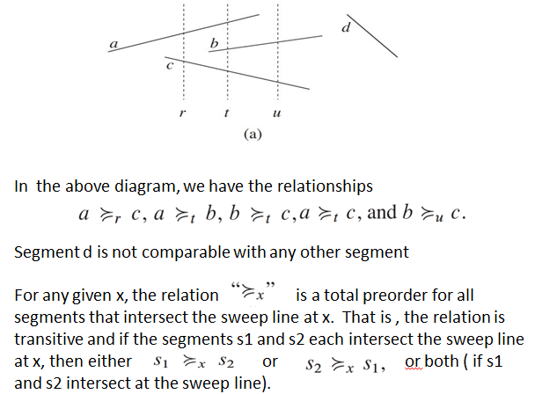

Slide 7

When segments e and f intersect, they reverse their order :
We have . Any sweep line ( such as Z ) that passes through the shaded region has e and f consecutive in the ordering given by the relation
A segment enters the ordering when its left endpoint is encountered by the sweep, and it leaves the ordering when its right endpoint is encountered
when the sweep line passes through the intersection of two segments the segments reverse their positions in the total preorder.

Slide 8
Moving the sweep line
Sweeping algorithms typically manage two sets of data:
1. The sweep-line status (ie.) Total Preorder List gives the relationships among the objects that the sweep line intersects.
2. The event-point schedule is a sequence of points, called event points, which we order from left to right according to their x-coordinates.
As the sweep progresses from left to right, whenever the sweep line reaches the x-coordinate of an event point, the sweep halts, processes the event point, and then resumes. Changes to the sweep-line status occur only at event points.

Slide 9
In particular, each segment endpoint is an event point.
We sort the segment endpoints by increasing x-coordinate and proceed from left to right.
When we encounter a segment’s left endpoint, we insert the segment into the sweep-line status, and we delete the segment from the sweep-line status upon encountering its right endpoint.
Whenever two segments first become consecutive in the total preorder, we check whether they intersect

Slide 10
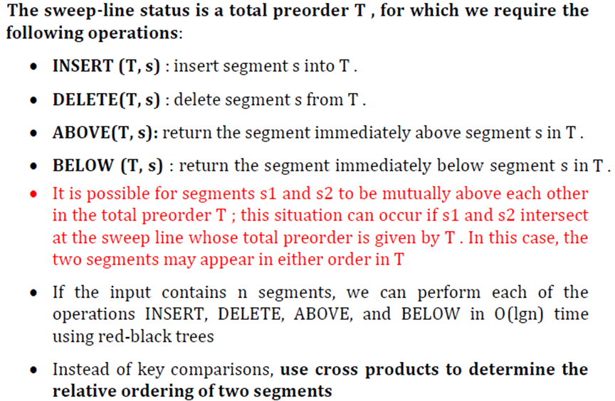

Slide 11
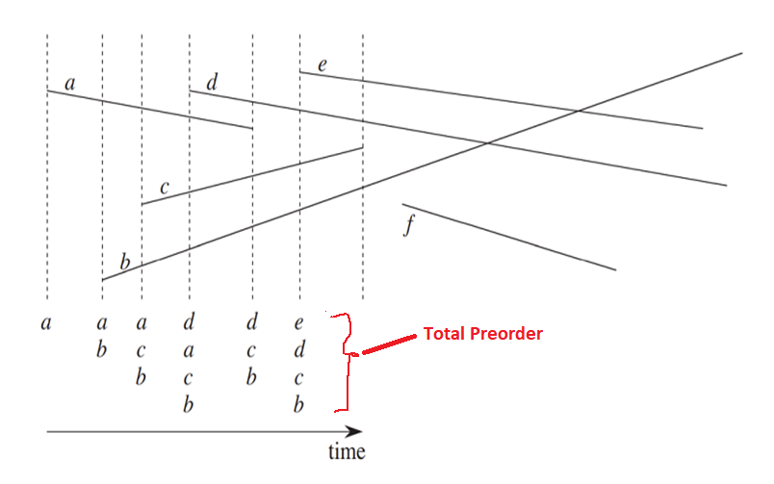

Slide 12
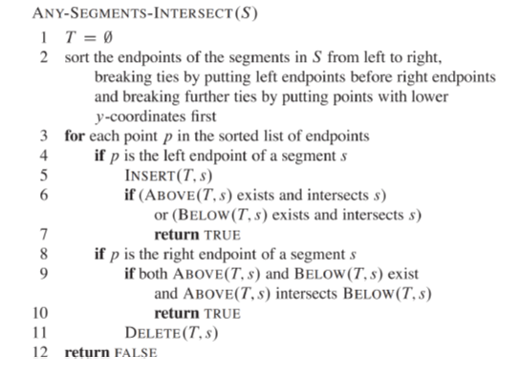
Segment Intersection Pseudo code
The following algorithm takes a set S of n line segments, returning the Boolean value TRUE if any pair of segments in S intersects , FALSE otherwise. A red-black tree maintains the total pre-order.
The algorithm uses a Red-Black tree (Balanced BST) to maintain intervals created at each event so that efficient search, insertion, and deletion can be done.

Slide 13
Line 1 initializes the total preorder to be empty
line 2 is by lexicographically sorting the endpoints on (x,e,y), where x and y are the usual coordinates, e = 0 for a left endpoint, and e = 1 for a right endpoint
Each iteration of the for loop of lines 3–11 processes one event point p. If p is the left endpoint of a segment s, line 5 adds s to the total preorder, and lines 6–7 return TRUE if s intersects either of the segments it is consecutive with in the total preorder defined by the sweep line passing through p
If p is the right endpoint of a segment s, then we need to delete s from the total preorder. But first, lines 9–10 return TRUE if there is an intersection between the segments surrounding s in the total preorder defined by the sweep line passing through p

Slide 14
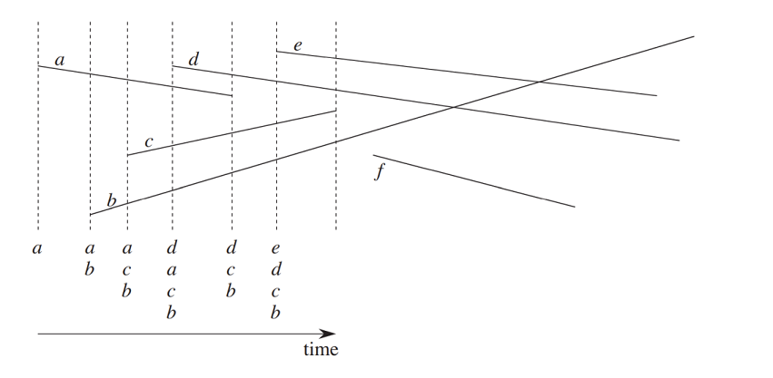
The execution of ANY-SEGMENTS-INTERSECT.
Each dashed line is the sweep line at an event point. Except for the rightmost sweep line, the ordering of segments names below each sweep line corresponds to the total preorder T at the end of the for loop processing the corresponding event point. The right most sweep line occurs when processing the right endpoint of segment c;

Slide 15
Running time
If set S contains n segments, then ANY-SEGMENTS-INTERSECT runs in time O(n lg n). Line 1 takes O(1) time. Line 2 takes O(n lg n) time, using merge sort or heapsort.
The for loop of lines 3–11 iterates at most once per event point, and so with 2n event points, the loop iterates at most 2n times.
Each iteration takes O(lg n) time, since each red-black-tree operation takes O(lg n) time and, each intersection test takes O(1) time. The total time is thus O(n lg n)

